Slide 1
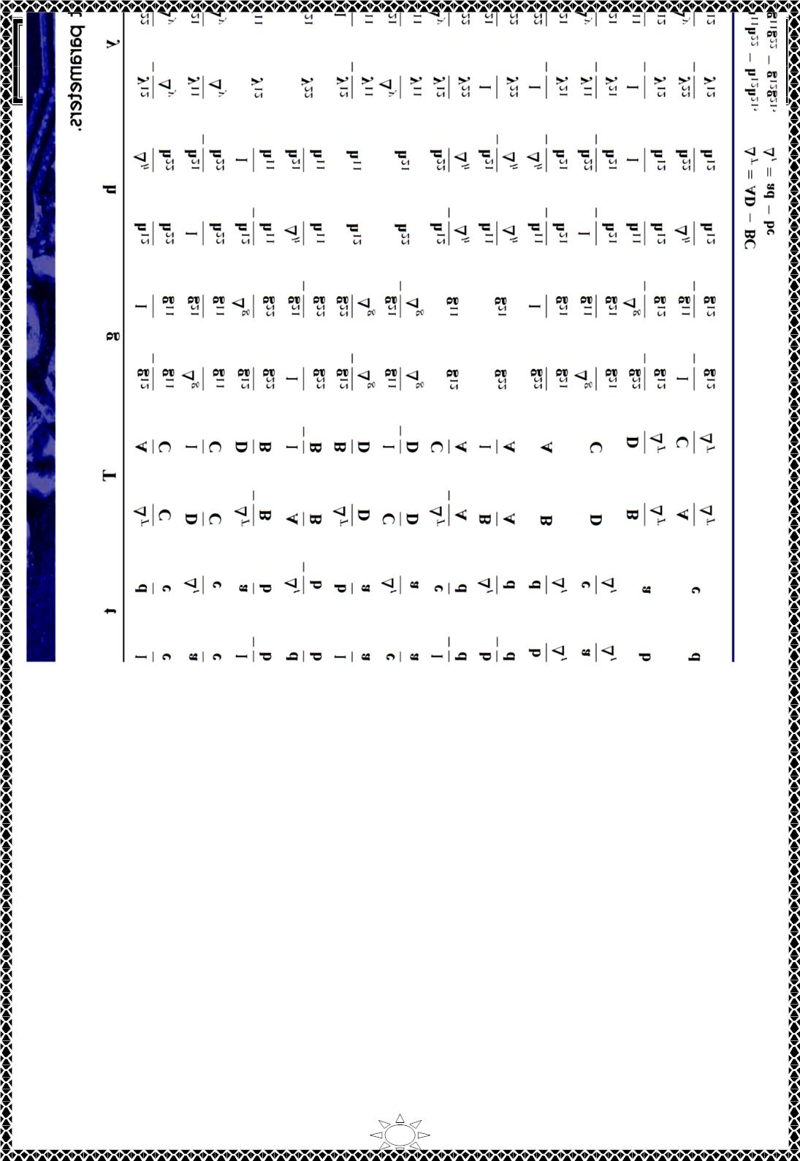
University of Diyala
Engineering College
Electronic Department
Electrical Circuits
2nd Class
Lecturer : Wisam N. AL-Obaidi
Year (2015-2016)
Trail Version
Trail Version
Trail Version
Trail Version
Trail Version
Trail Version
Trail Version
Trail Version
Trail Version
Trail Version
Trail Version
Trail Version
Trail Version
24

Slide 2
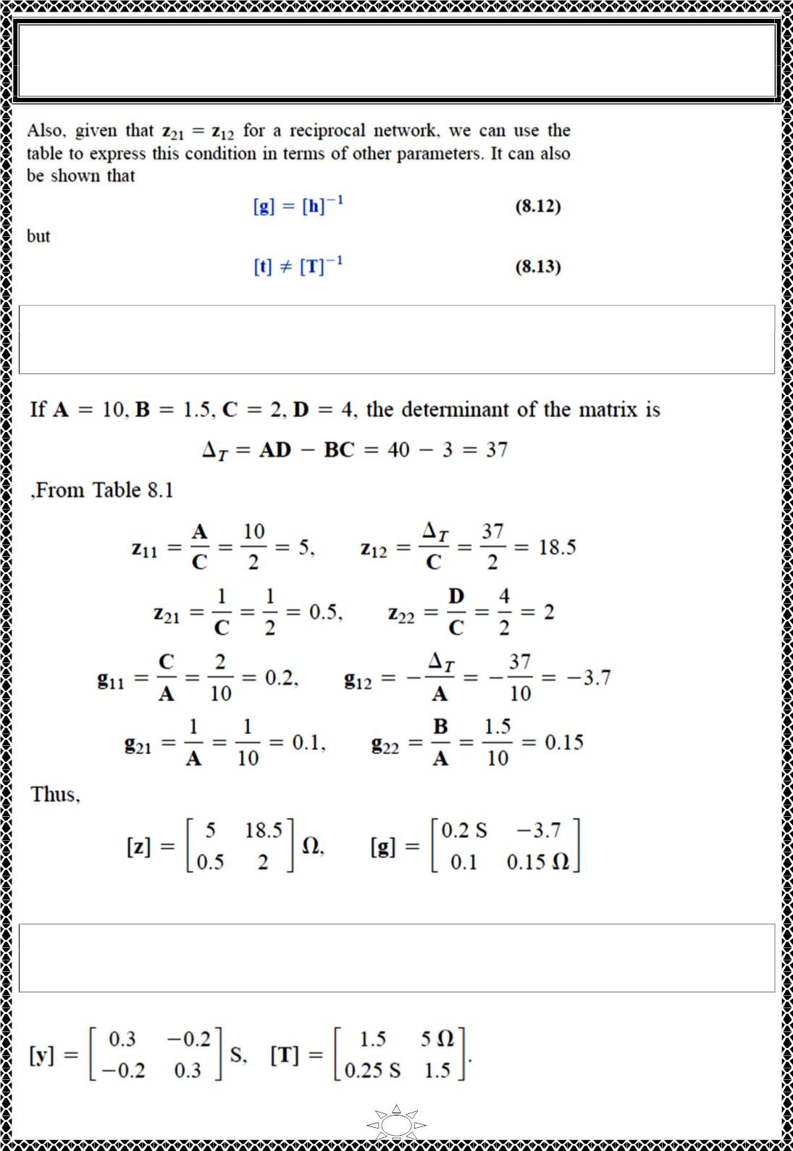
University of Diyala
Engineering College
Electronic Department
Electrical Circuits
2nd Class
Lecturer : Wisam N. AL-Obaidi
Year (2015-2016)
Example 10: Find [푧] and [푔] of a two-port network if
[푇] = ꢀ
10 1.5Ω
2 푆
4
ꢁ
Solution:
Trail Version
Trail Version
Trail Version
Trail Version
Trail Version
Trail Version
Trail Version
Trail Version
Trail Version
Trail Version
Trail Version
Trail Version
Trail Version
H.W.10: Determine [푦] and [푇] of a two-port network whose z parameters are
[푧] = ꢀ
6 4
4 6
ꢁ Ω
Answer:
25

Slide 3
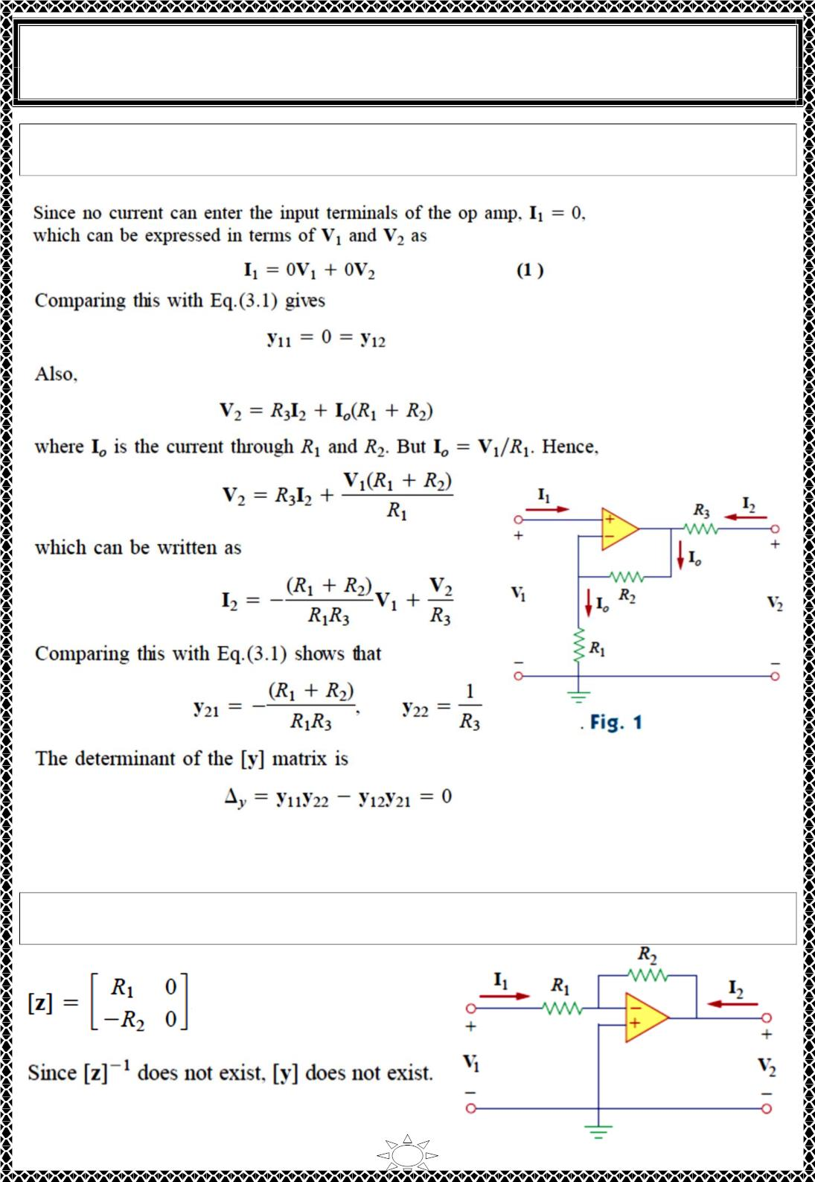
University of Diyala
Engineering College
Electronic Department
Electrical Circuits
2nd Class
Lecturer : Wisam N. AL-Obaidi
Year (2015-2016)
Example 11: Obtain the y parameters of the op amp circuit in Fig. 1. Show that the circuit
has no z parameters
Solution:
Trail Version
Trail Version
Trail Version
Trail Version
Trail Version
Trail Version
Trail Version
Trail Version
Trail Version
Trail Version
Trail Version
Trail Version
Trail Version
Since Δ_{푦} = 0, the [y] matrix has no inverse; therefore, the [z] matrix does not exist
according to Eq. (8.4). Note that the circuit is not reciprocal because of the active element
H.W.11: Find the z parameters of the op amp circuit in Fig. Show that the circuit has no y
parameters.
Answer:
26

Slide 4
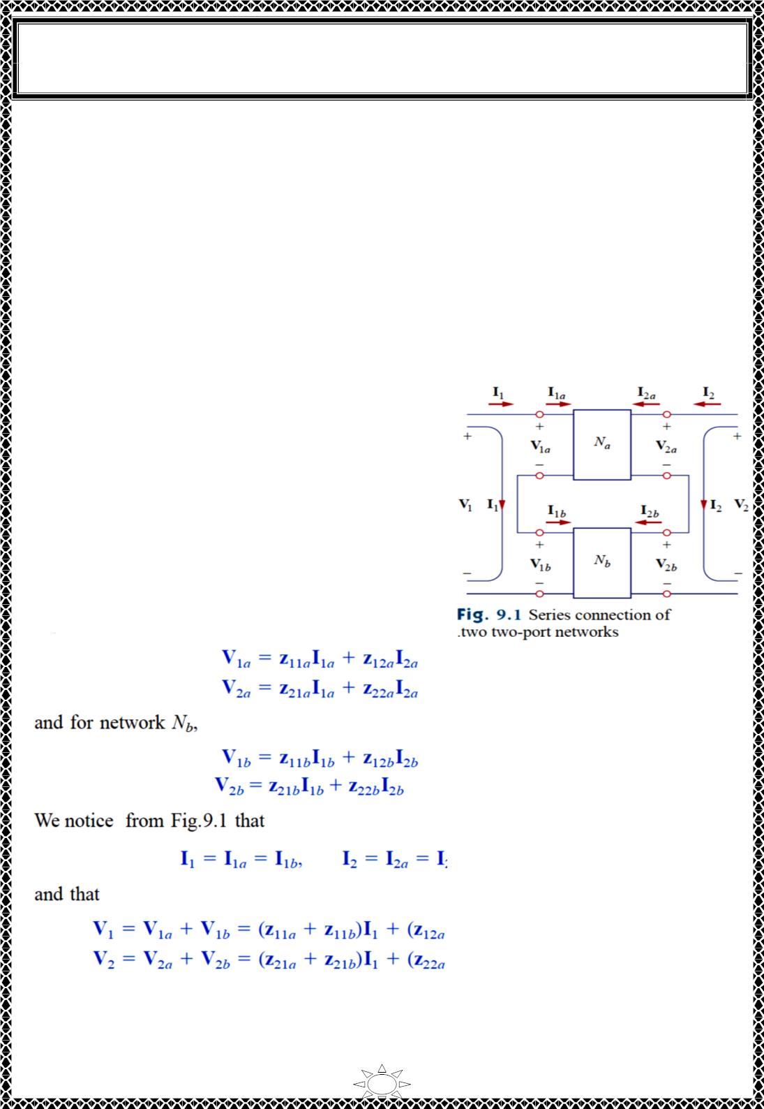
University of Diyala
Engineering College
Electronic Department
Electrical Circuits
2nd Class
Lecturer : Wisam N. AL-Obaidi
Year (2015-2016)
8)Interconnection of Networks
A large, complex network may be divided into subnetworks for the purposes of analysis
and design. The subnetworks are modeled as twoport networks, interconnected to form the
original network.
The interconnection can be in series, in parallel, or in cascade. Although the
interconnected network can be described by any of the six parameter sets, a certain set of
parameters may have a definite advantage. For example, when the networks are in series,
their individual z parameters add up to give the z parameters of the larger network. When
they are in parallel, their individual y parameters add up to give the y parameters of the larger
network. When they are cascaded, their individual transmission parameters can be multiplied
together to get the transmission parameters of the larger network.
8.1) series connection
Consider the two two-port networks (in Fig. 9.1.)
The networks are in series because their input
currents are the same and their voltages add. In
addition, each network has a common reference,
and when the circuits are placed in series, the
common reference points of each circuit are
connected together. For network N_{a} ,
Trail Version
Trail Version
Trail Version
Trail Version
Trail Version
Trail Version
Trail Version
Trail Version
Trail Version
Trail Version
Trail Version
Trail Version
Trail Version
27

Slide 5
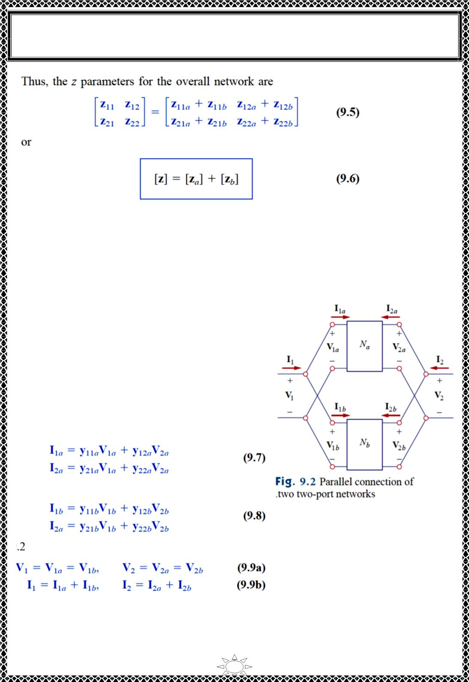
University of Diyala
Engineering College
Electronic Department
Electrical Circuits
2nd Class
Lecturer : Wisam N. AL-Obaidi
Year (2015-2016)
z parameters for the overall network are the sum of the z parameters for the individual
networks. This can be extended to n networks in series. If two two-port networks in the [h]
model, for example, are connected in series, we use Table 8.1 to convert the h to z and
then apply Eq. (9.6). We finally convert the result back to h using Table 8.1
8.2) parallel connection
Two two-port networks are in parallel when their
port voltages are equal and the port currents of the
larger network are the sums of the individual port
currents. In addition, each circuit must have a
common reference and when the networks are
connected together, they must all have their
common references tied together. The parallel
connection of two two-port networks is shown in
Fig. 9.2. For the two networks,
Trail Version
Trail Version
Trail Version
Trail Version
Trail Version
Trail Version
Trail Version
Trail Version
Trail Version
Trail Version
Trail Version
Trail Version
Trail Version
28

Slide 6
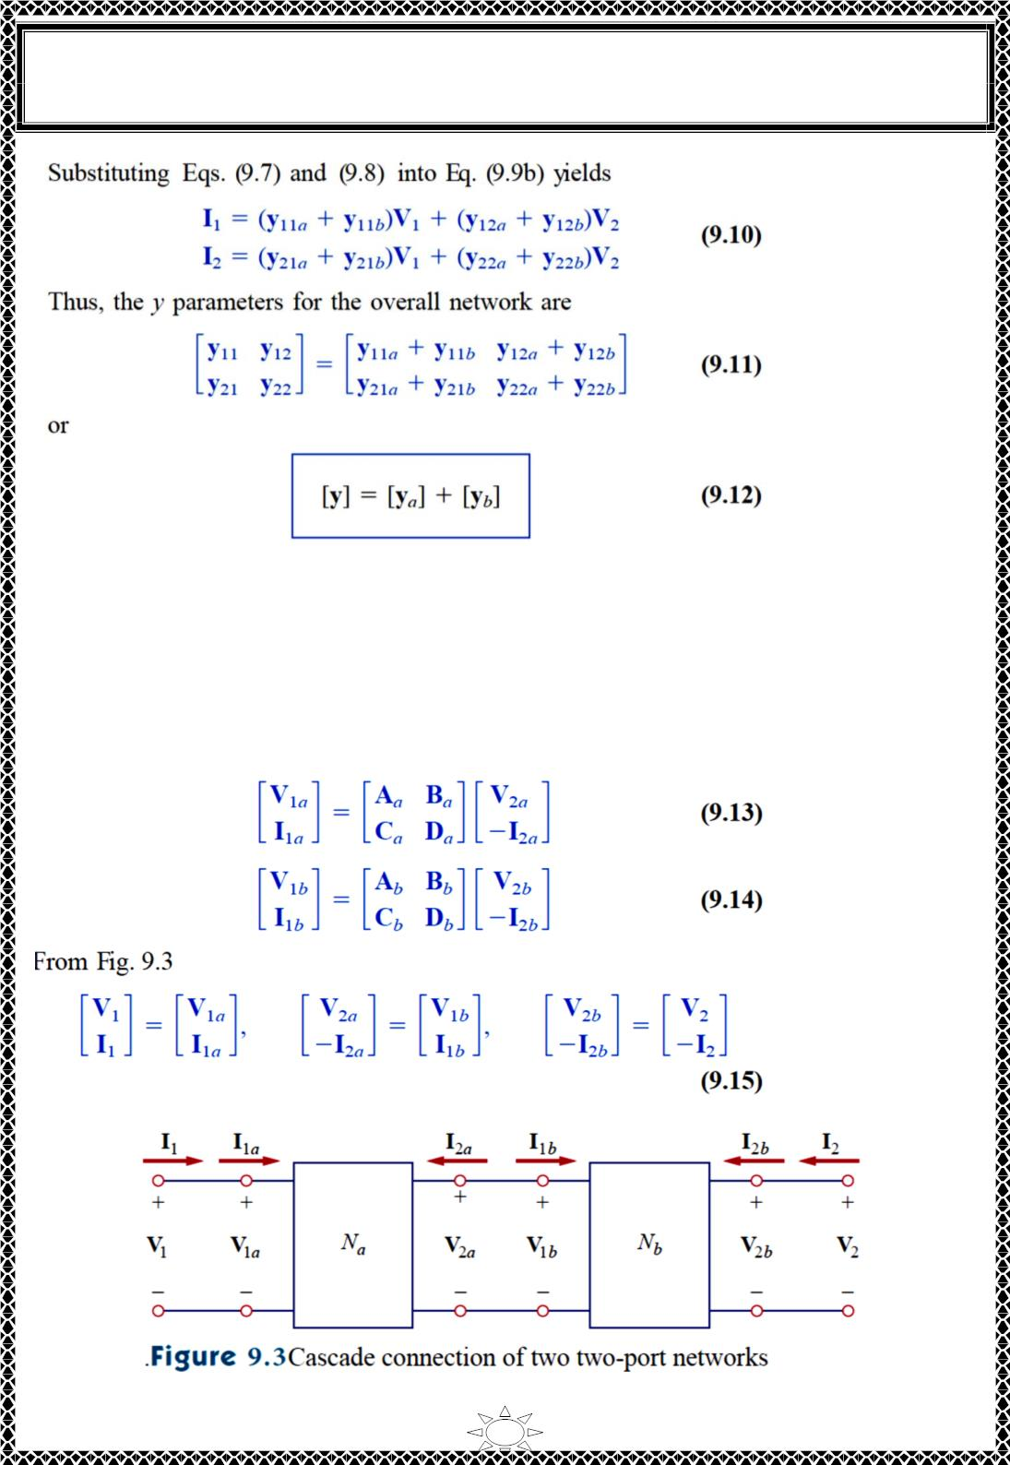
University of Diyala
Engineering College
Electronic Department
Electrical Circuits
2nd Class
Lecturer : Wisam N. AL-Obaidi
Year (2015-2016)
showing that the y parameters of the overall network are the sum of the y parameters of the
individual networks. The result can be extended to n two-port networks in parallel.
8.3) cascaded connection
Trail Version
Trail Version
Trail Version
Trail Version
Trail Version
Trail Version
Trail Version
Trail Version
Trail Version
Trail Version
Trail Version
Trail Version
Trail Version
Two networks are said to be cascaded when the output of one is the input of the other. The
connection of two two-port networks in cascade is shown in Fig. 9.3. For the two
networks,
29

Slide 7
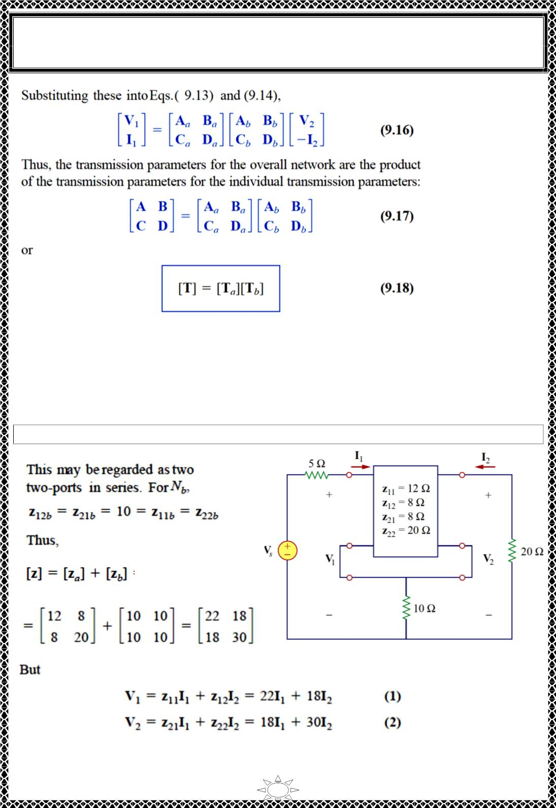
University of Diyala
Engineering College
Electronic Department
Electrical Circuits
2nd Class
Lecturer : Wisam N. AL-Obaidi
Year (2015-2016)
It is this property that makes the transmission parameters so useful. Keep in mind that the
multiplication of the matrices must be in the order in which the networks Na and Nb are
cascaded.
Trail Version
Trail Version
Trail Version
Trail Version
Trail Version
Trail Version
Trail Version
Trail Version
Trail Version
Trail Version
Trail Version
Trail Version
Trail Version
Example 12: Evaluate V2 / Vs in the circuit in Fig.
Solution:
30

Slide 8
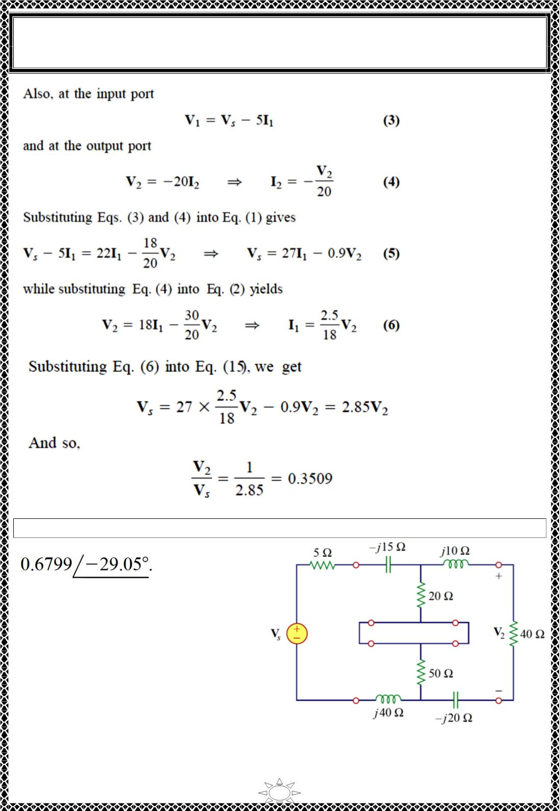
University of Diyala
Engineering College
Electronic Department
Electrical Circuits
2nd Class
Lecturer : Wisam N. AL-Obaidi
Year (2015-2016)
Trail Version
Trail Version
Trail Version
Trail Version
Trail Version
Trail Version
Trail Version
Trail Version
Trail Version
Trail Version
Trail Version
Trail Version
Trail Version
H.W.12: Find V2 / Vs in the circuit in Fig.
Answer:
31

Slide 9
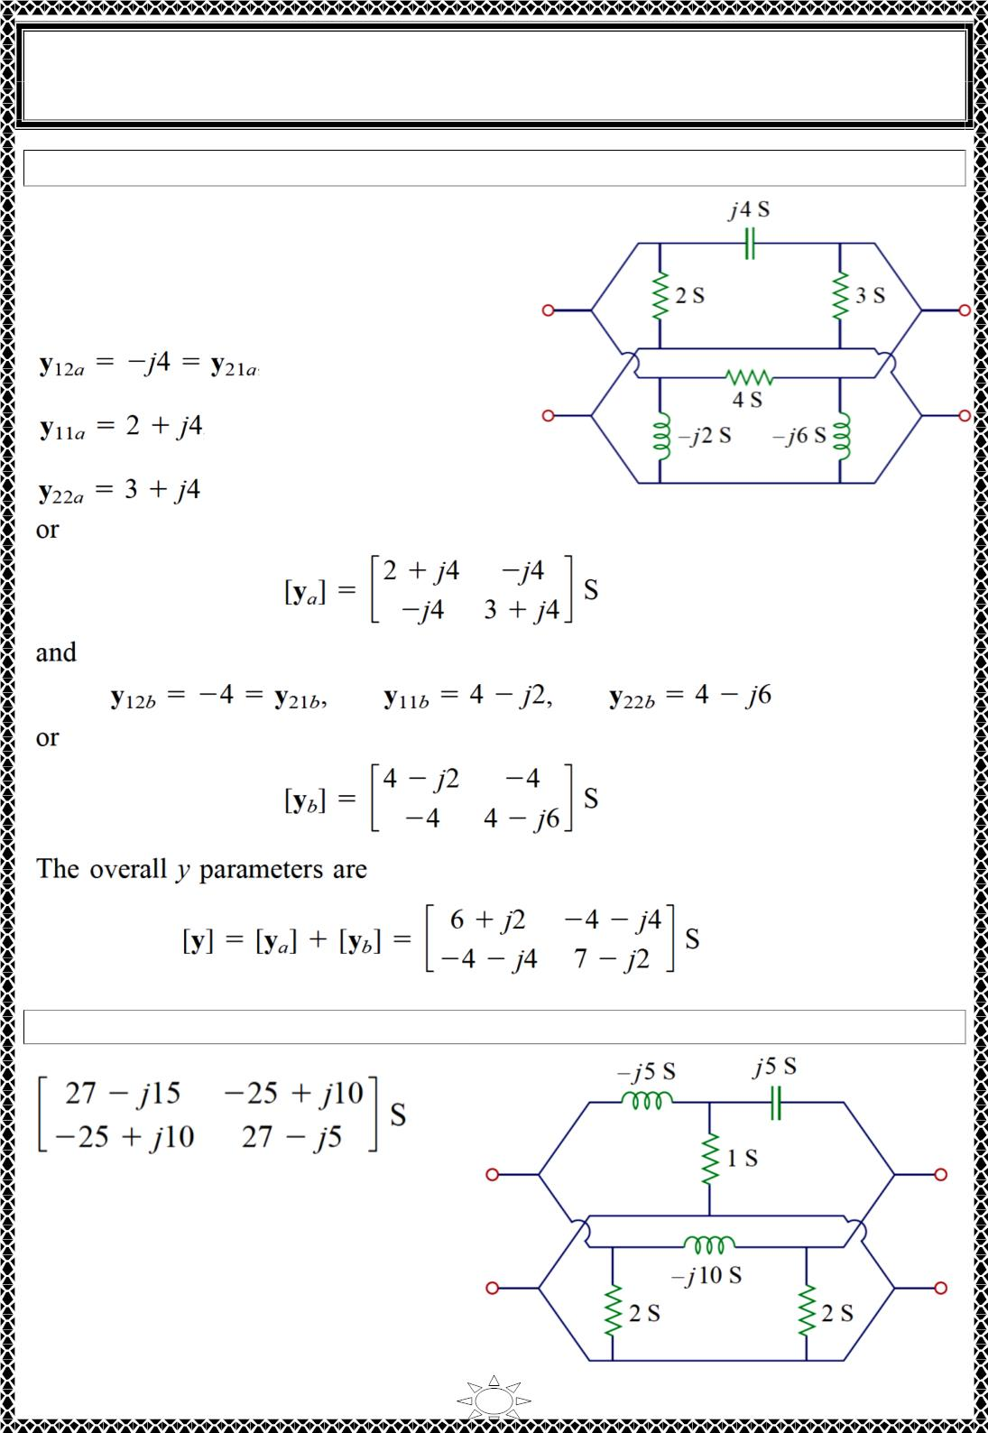
University of Diyala
Engineering College
Electronic Department
Electrical Circuits
2nd Class
Lecturer : Wisam N. AL-Obaidi
Year (2015-2016)
Example 13: Find the y parameters of the two-port in Fig.
Solution:
Let us refer to the upper network as N_{a} and the
lower one as N_{b}. The two networks are
connected in parallel. Comparing N_{a} and N_{b}
with the circuit in Fig. 3.2(a), we obtain
Trail Version
Trail Version
Trail Version
Trail Version
Trail Version
Trail Version
Trail Version
Trail Version
Trail Version
Trail Version
Trail Version
Trail Version
Trail Version
H.W.13: Obtain the y parameters for the network in Fig.
Answer:
32

Slide 10
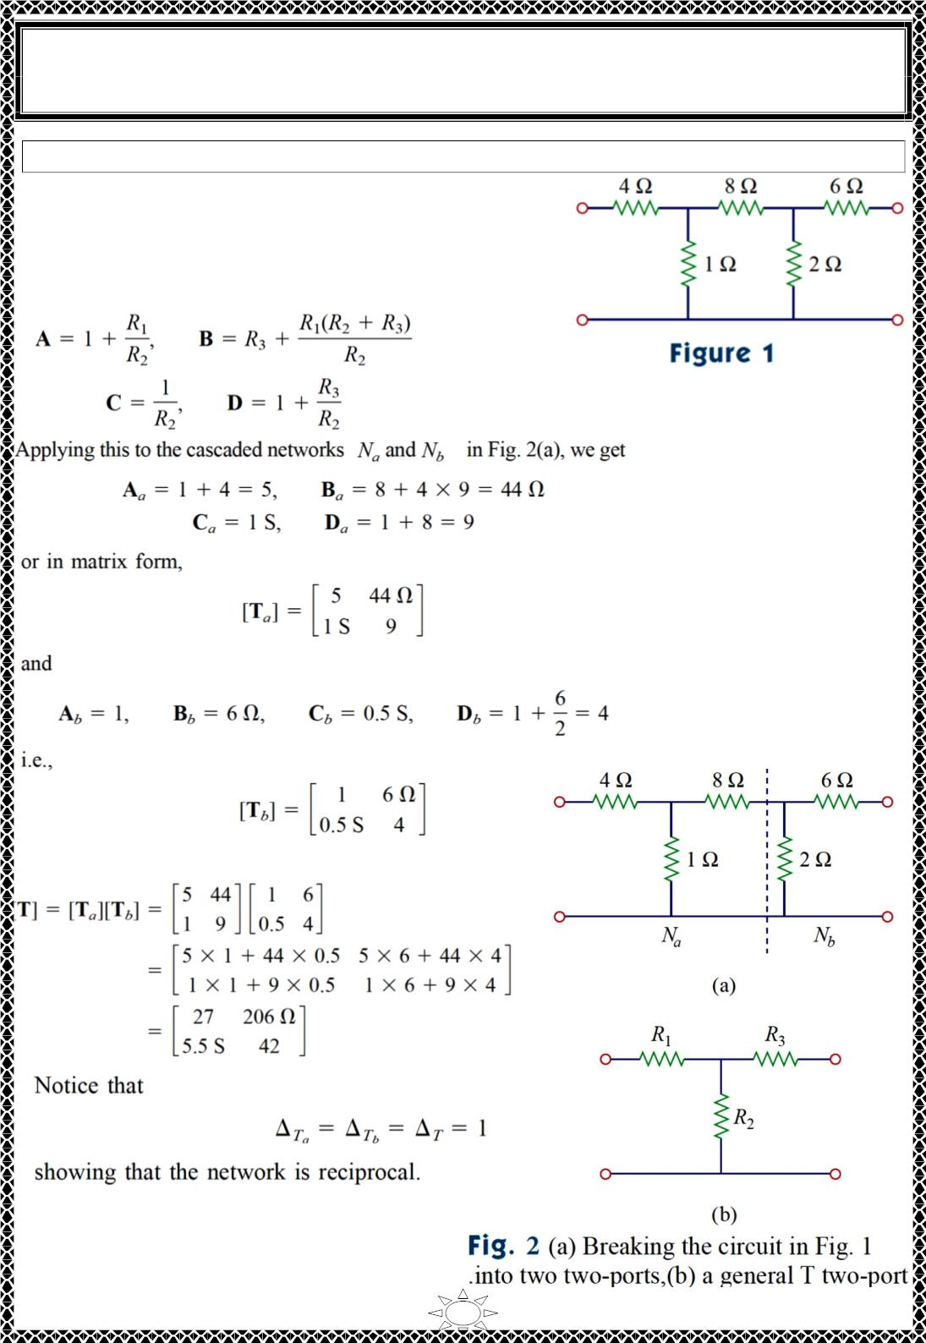
University of Diyala
Engineering College
Electronic Department
Electrical Circuits
2nd Class
Lecturer : Wisam N. AL-Obaidi
Year (2015-2016)
Example 14: Find the transmission parameters for the circuit in Fig.
Solution:
We can regard the given circuit in Fig. 1 as a cascade
connection of two T networks as shown in Fig. 2(a).
We can show that a T network, shown in Fig. 2(b), has
the following transmission parameters
Trail Version
Trail Version
Trail Version
Trail Version
Trail Version
Trail Version
Trail Version
Trail Version
Trail Version
Trail Version
Trail Version
Trail Version
Trail Version
Thus for total network in Fig. 1,
33

